Slide 1

MAVEN FUZZY FACTORY DATA ANALYSIS By :- Pranit Akhade
GITHUB : https://github.com/pranitakhade/Maven-Fuzzy-Factory-MySQL-Data-Analysis

Slide 2
INTRODUCING THE PROJECT
THE
SITUATION
You’ve just been hired as an eCommerce Database Analyst for Maven Fuzzy Factory, an online retailer which has just launched their first product.
As a member of the startup team, you will work with the CEO, the Head of Marketing, and the
Website Manager to help steer the business.
THE
BRIEF
You will analyze and optimize marketing channels, measure and test website conversion performance, and use data to understand the impact of new product launches.
THE
OBJECTIVE
Use SQL to:
Access and explore the Maven Fuzzy Factory database
Become the data expert for the company, and the go-to person for mission critical analyses
Analyze and optimize the business’ marketing channels, website, and product portfolio

Slide 3
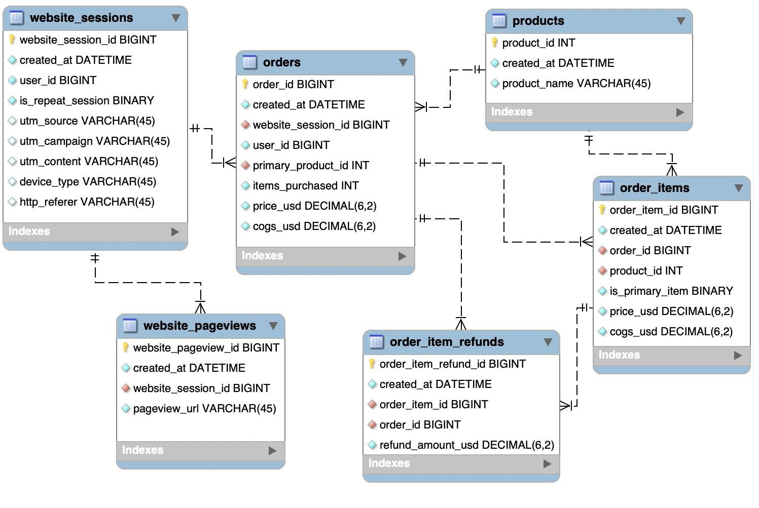
OVERVIEW OF THE MAVEN FUZZY FACTORY DATABASE
We will be working with six related tables, which contain eCommerce data about:
Website Activity
Products
Orders and Refunds
We'll use MySQL to understand how customers access and interact with the site, analyze landing page performance and conversion, and explore product-level sales.

Slide 4

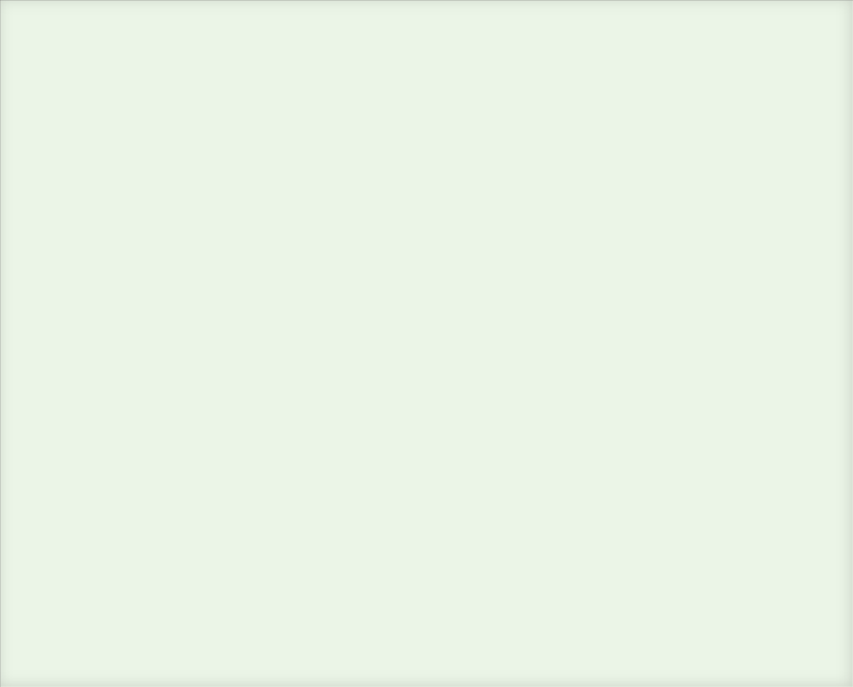
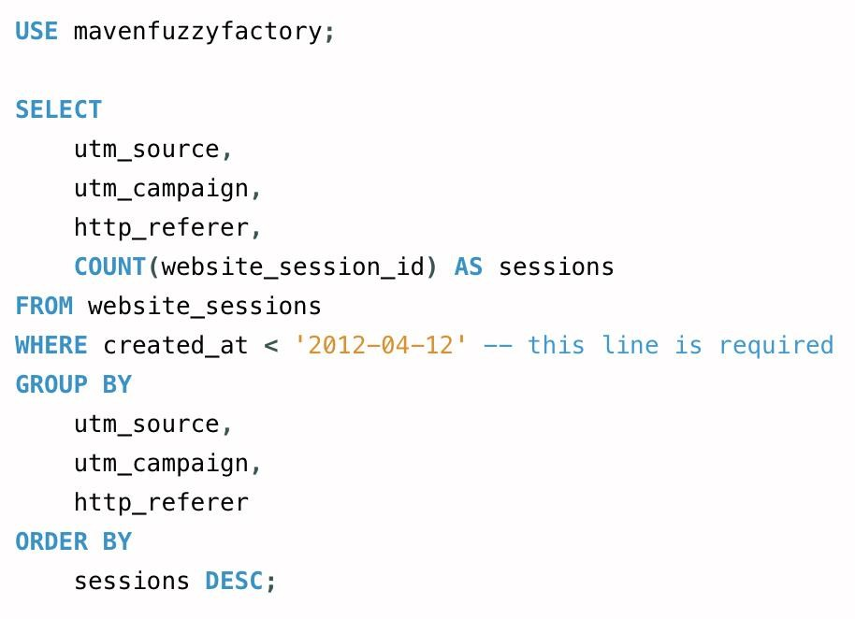
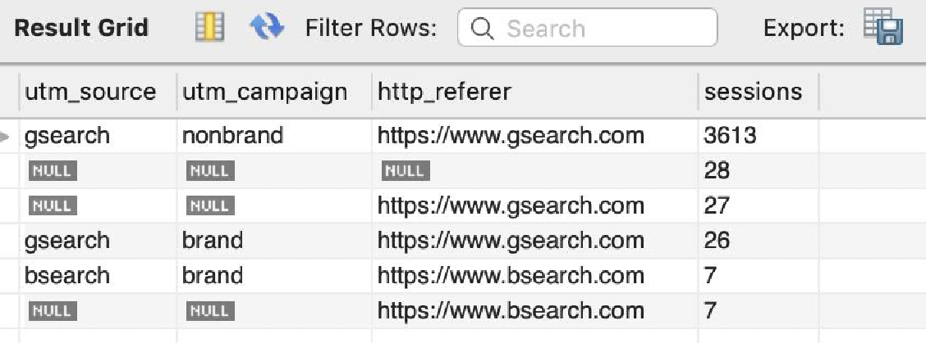
Where are the bulk of our website sessions coming from, through yesterday? Can you provide a breakdown by UTM source, campaign, and referring domain?
Solution Query
Result Grid

Slide 5
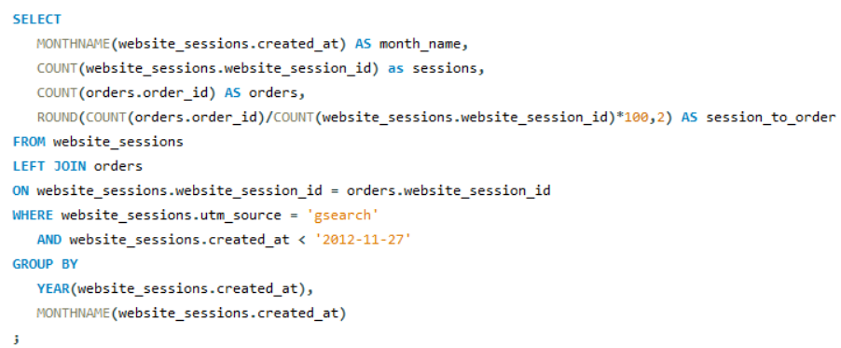
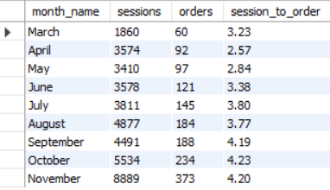
Gsearch seems to be the biggest driver of our business. Could you pull monthly trends for gsearch sessions and orders so that we can showcase the growth there?
Solution Query
Result Grid

Slide 6
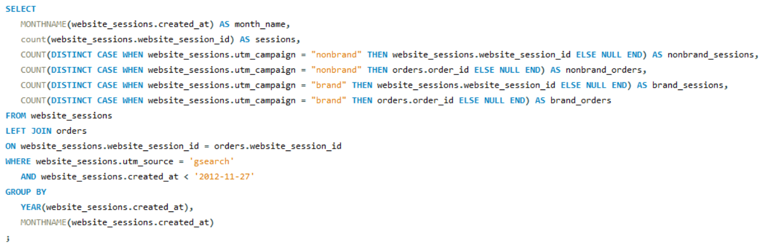
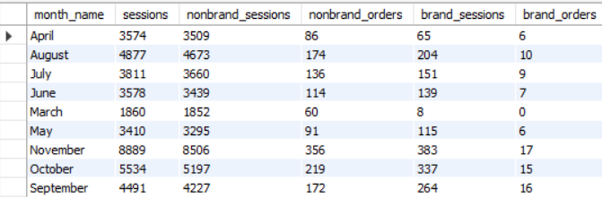
Next, it would be great to see a similar monthly trend for Gsearch, but this time splitting out nonbrand and brand campaigns separately. I am wondering if brand is picking up at all. If so, this is a good story to tell.
Solution Query
Result Grid

Slide 7
Next, it would be great to see a similar monthly trend for Gsearch, but this time splitting out nonbrand and brand campaigns separately. I am wondering if brand is picking up at all. If so, this is a good story to tell.
Solution Query
Result Grid

Slide 8
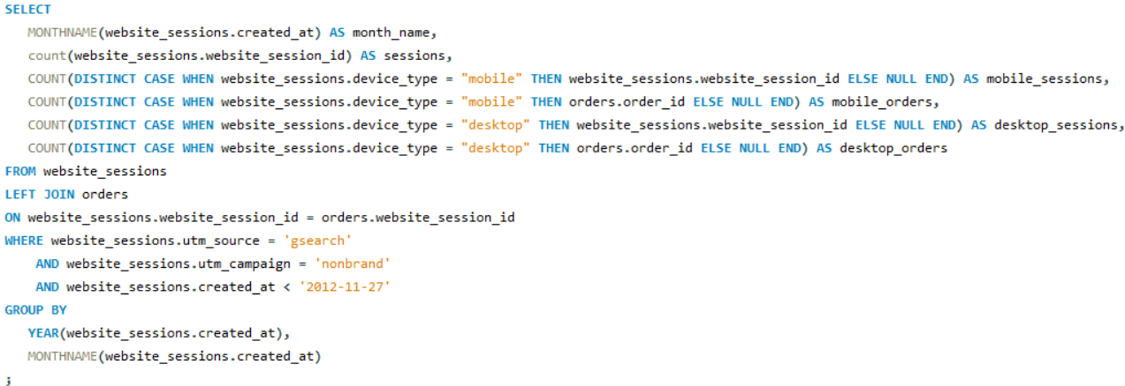
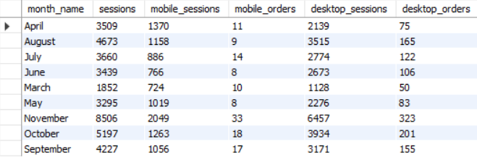
While we’re on Gsearch, could you dive into nonbrand, and pull monthly sessions and orders split by device type?
Solution Query
Result Grid

Slide 9
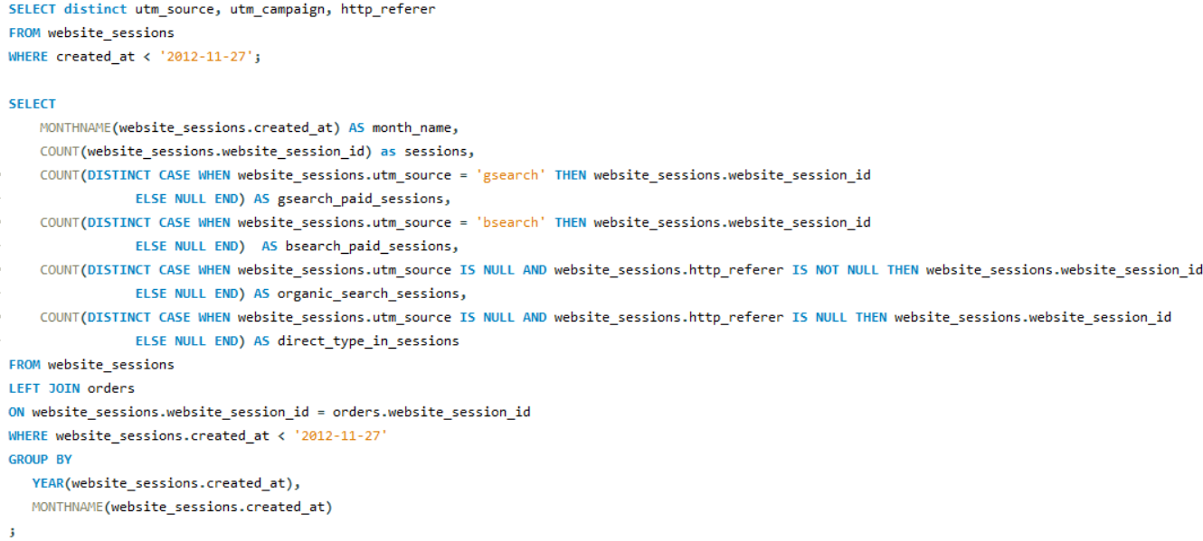
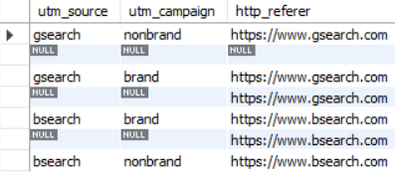
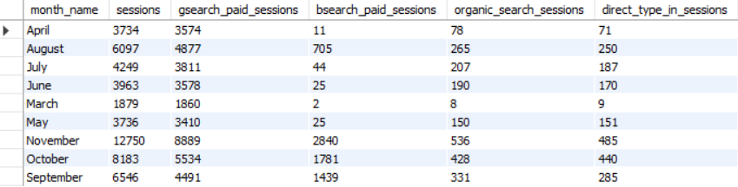
Can you pull monthly trends for Gsearch, alongside monthly trends for each of our other channels?
Solution Query
Result Grid

Slide 10
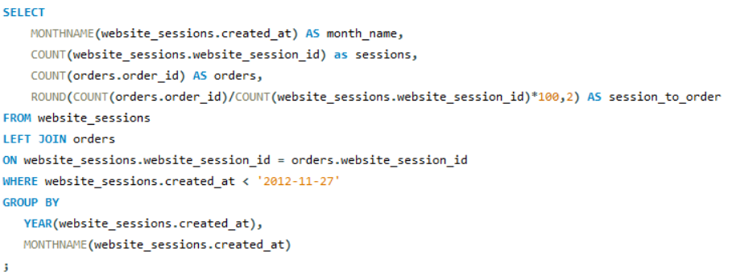
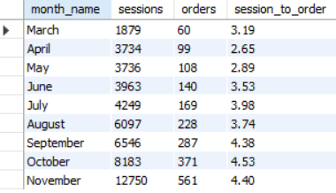
I’d like to tell the story of our website performance improvements over the course of the first 8 months. Could you pull session to order conversion rates, by month?
Solution Query
Result Grid

Slide 11
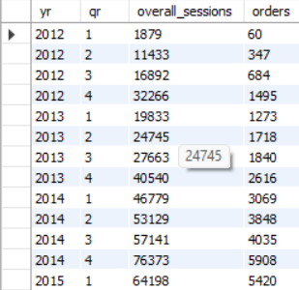
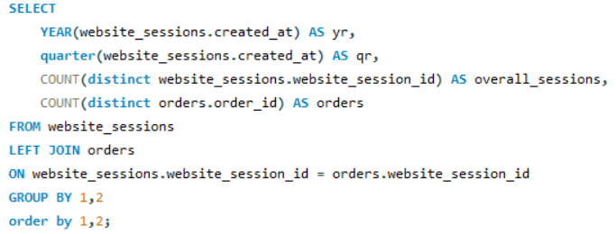
First, I’d like to show our volume growth. Can you pull overall session and order volume, trended by quarter for the life of the business? Since the most recent quarter is incomplete, you can decide how to handle it.
Solution Query
Result Grid

Slide 12
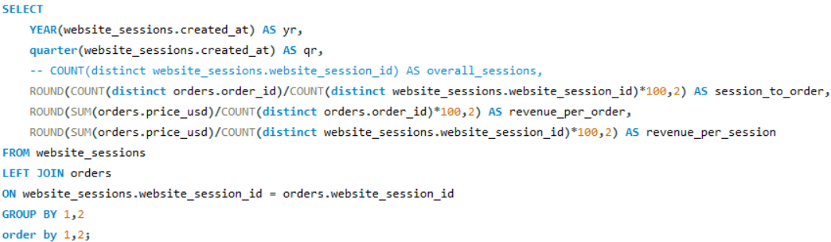
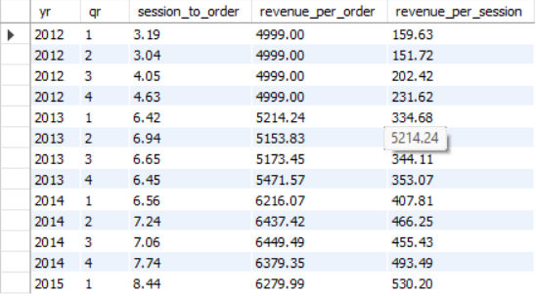
Next, let’s showcase all of our efficiency improvements. I would love to show quarterly figures since we launched, for session-to-order conversion rate, revenue per order, and revenue per session.
Solution Query
Result Grid

Slide 13
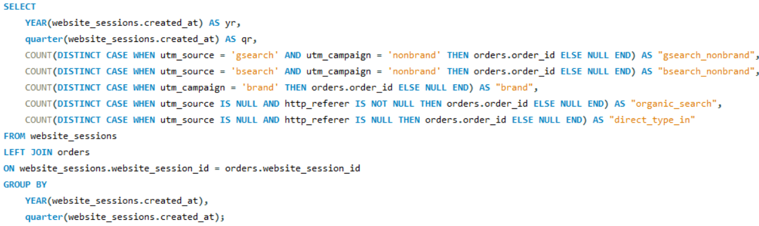
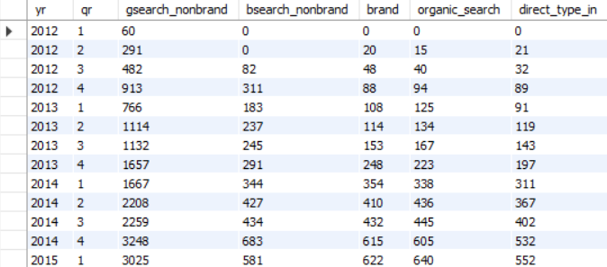
I’d like to show how we’ve grown specific channels. Could you pull a quarterly view of orders from Gsearch nonbrand, Bsearch nonbrand, brand search overall, organic search, and direct type-in?
Solution Query
Result Grid

Slide 14
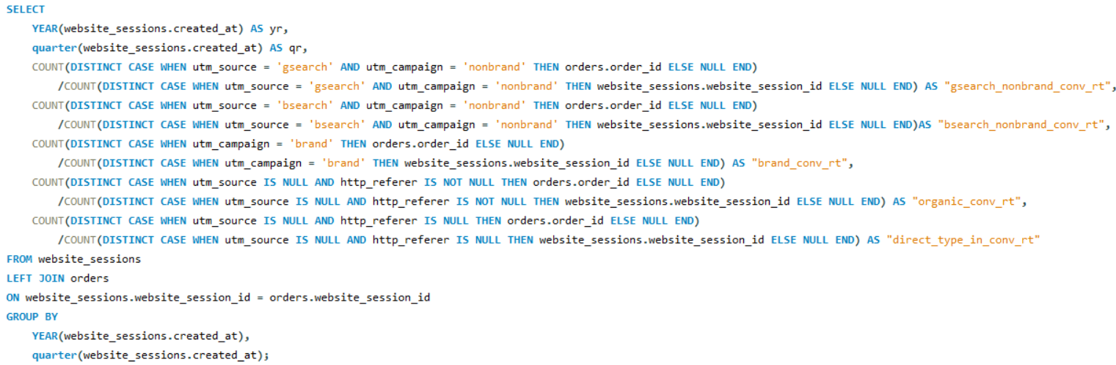
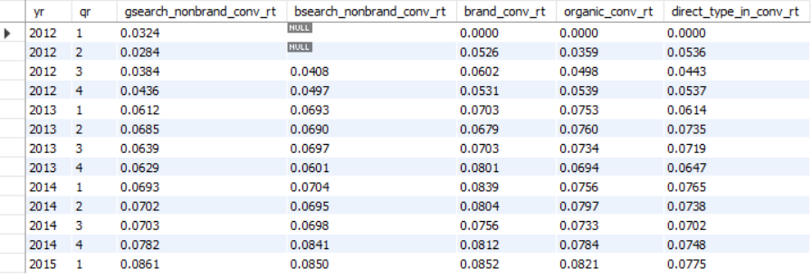
Next, let’s show the overall session-to-order conversion rate trends for those same channels, by quarter. Please also make a note of any periods where we made major improvements or optimizations.
Solution Query
Result Grid

Slide 15
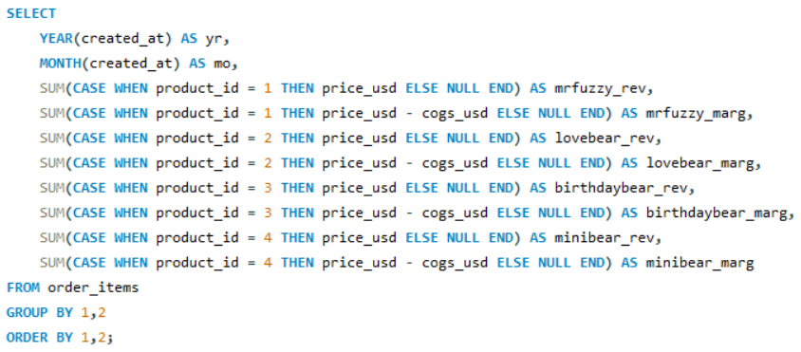
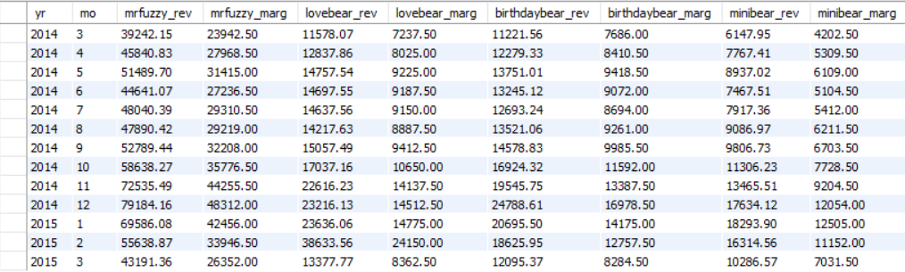
We’ve come a long way since the days of selling a single product. Let’s pull monthly trending for revenue and margin by product, along with total sales and revenue. Note anything you notice about seasonality.
Solution Query
Result Grid

Slide 16
Thank You
GITHUB : https://github.com/pranitakhade/Maven-Fuzzy-Factory-MySQL-Data-Analysis

